Slide 1

Soroptimist is Growing
Barbara Spyke, SI Southern Region Governor

Slide 2
Our Numbers
Spring 2024 total SR Members 286
Spring 2025 total SR Members 335 (2 new clubs)
Spring 2026 total SR Members 343
In July 2024 we lost 41 members
In July 2025 we lost 12 members.

Slide 3
Member Retention - Board & President’s Meetings
Member Retention:
Use mentors, they can be the member that brought them in
Give new members a role, until they are engaged they will feel like a guest
Partner possible leaders with an existing officer
It’s ok to let some members go
Have an expectation that will do tasks, so they show up
Invite new members to audit Committee meetings
Member appreciation Party
Social Outings, Help your members become Friends
Are your meetings interesting and worth attending?

Slide 4

Congratulations!
Great job with
Membership Retention,
Soroptimist is Growing!

Slide 5
Governor’s Strategies
My main goal is to retain membership and grow existing clubs. Here are four of my strategies:
· Focus on our Mission: "Providing women and girls with access to the education and training they need to achieve economic empowerment." This focus helps us overlook minor issues within the club or with other members.

Slide 6
Governor’s Strategies
· Advertise meetings: The simplest way is to create Facebook events, which takes less than 5 minutes, making it easier for women to find us and increasing visibility through algorithms.

Slide 7
Governor’s Strategies
· Promote social activities: Highlight that members are friends, making it harder for them to leave and easier to justify their time spent in Soroptimist. Social connections improve
well-being and longevity.

Slide 8
Governor’s Strategies
· Collaborate with other clubs: Join with other clubs for events and socials. This can help create a larger audience and foster support among Southern Region clubs. Effective promotion of meetings and events is necessary for participation from surrounding clubs.

Slide 9
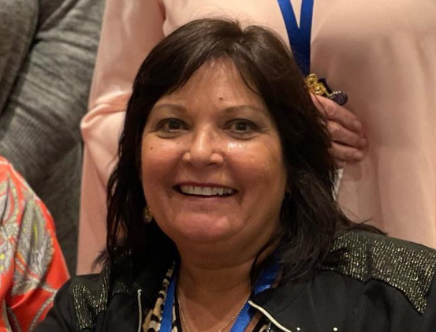
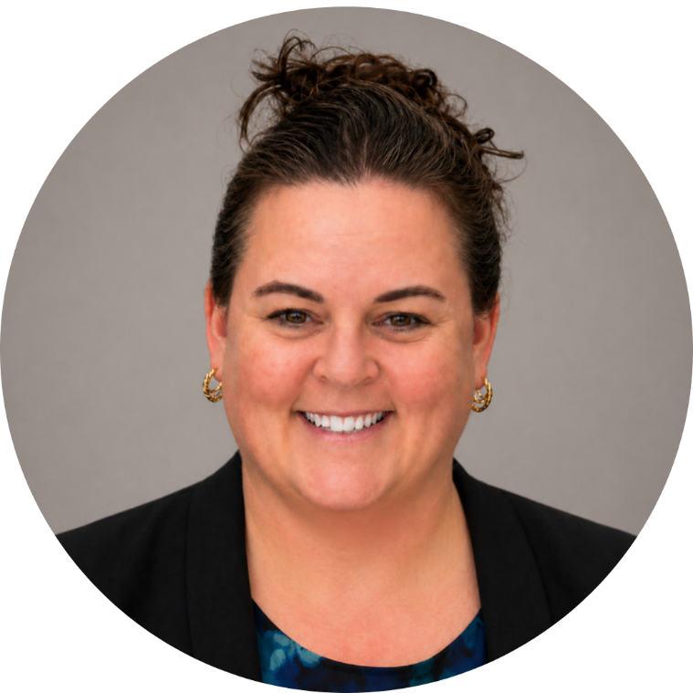
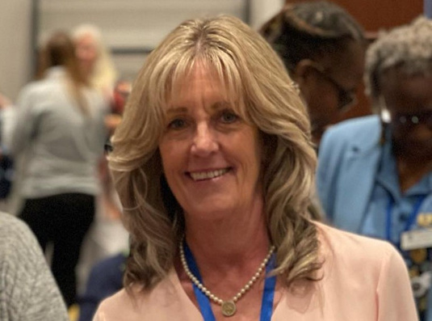
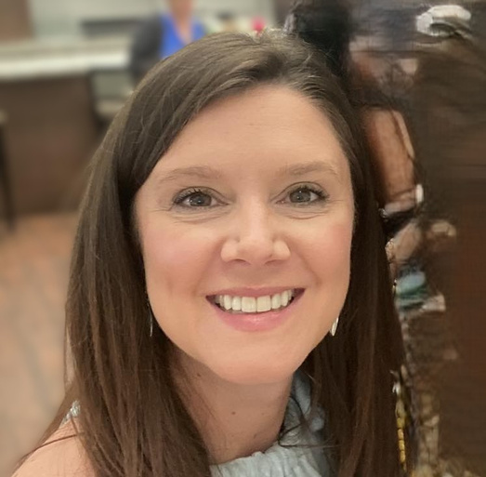
Conference 2026 Assistance
Megan - SI Homestead
Gov. Elect Kacie
Yvette - SI Homestead
Asst. Conference Chair
Denise - SI Homestead
SI Tuscaloosa
Conference Chair
Southern Regin Treasurer

Slide 10
Thank you

