Slide 1

Club Identity & Global Brand
How They Work Together
SOROPTIMIST INTERNATIONAL OF THE AMERICAS, INC
Notes:
Welcome everyone! My name is Ann Smallman and I’m with the Stuart club. In this session, we’re going to talk about how your club’s unique personality fits beautifully within Soroptimist International of the Americas’ global brand. This isn’t about limiting creativity—it’s about amplifying your impact so your club is instantly recognizable, trusted, and taken seriously, while still feeling authentic.

Slide 2
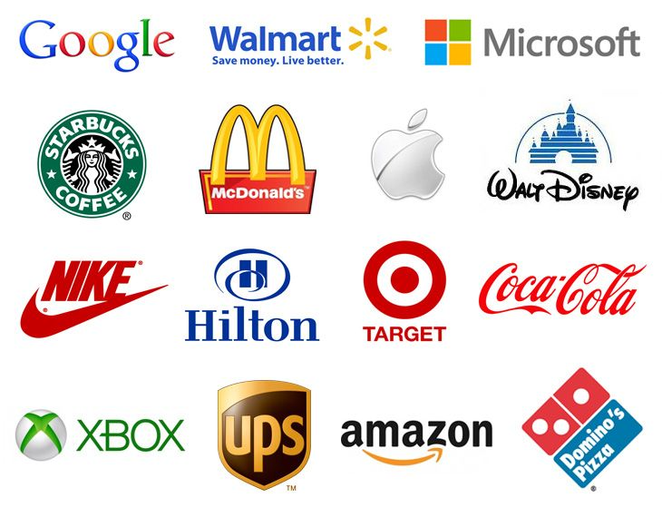

Why Branding Matters – Even at the Club Level
Branding = recognition, trust and credibility
Consistency helps people understand who we are and what we do
Strong brands attract members, partners and supporters
Notes:
When people see your club’s name, a flyer, a social post or a news article, they’re making a snap judgment—often in just a few seconds. Consistent branding helps them quickly recognize Soroptimist, understand our mission and trust that your club is part of something credible and established.
All of these brands are consistent with their branding, and as consumers, we already know what to expect in regard to product quality and service. And each of the thousands of locations offering these products and services leverages the brand's reputation.
Even small things—like a flyer, a Facebook post or an event banner—play a role in how people see your club and Soroptimist as a whole. This matters whether you’re recruiting members, partnering with local organizations or engaging the media.

Slide 3
What is Our Global Brand?
Our shared mission,
Our visual identity:
Our voice:
empowering, credible, optimistic and inclusive
vision and values
logo, colors, fonts, and imagery
Notes:
The same holds true for us. Our global brand is what connects every Soroptimist club around the world. It’s not just our logo—it’s our mission to invest in the dreams of women and girls, how we present ourselves visually and how we communicate.
When clubs align with this global brand, they benefit from the strength and reputation of the entire organization. People may meet your club locally, but they trust it more quickly because it’s clearly part of something bigger.

Slide 4
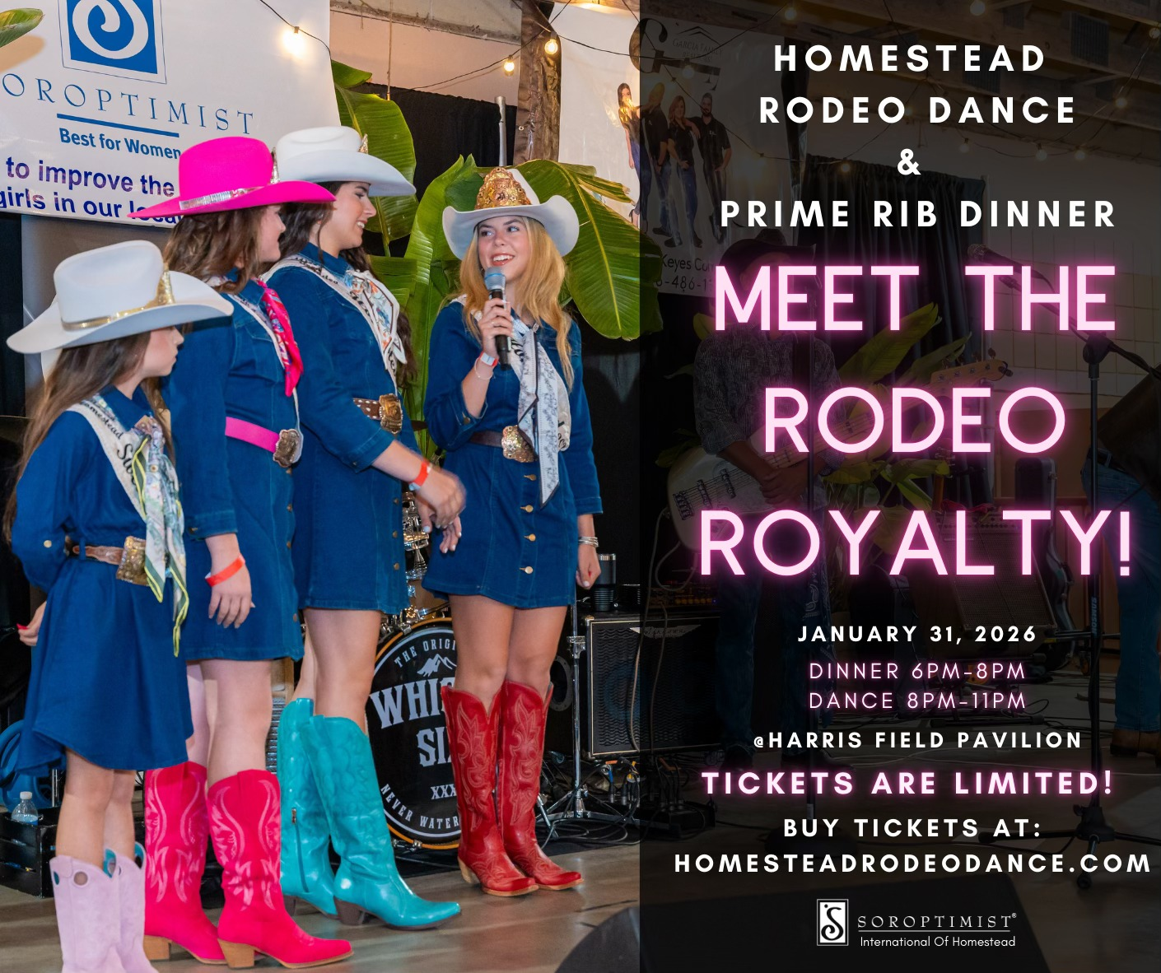
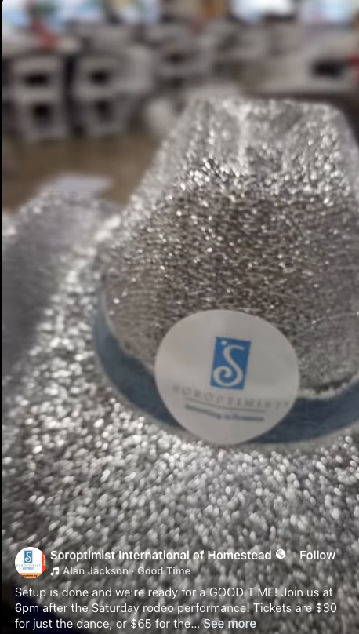

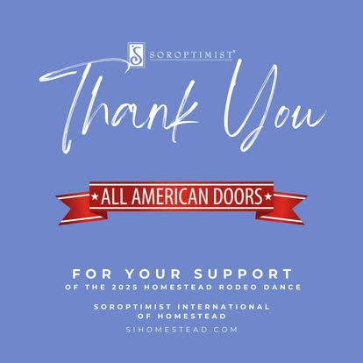
What is Club Identity?
Your club’s personality and local culture
Your community focus and signature projects
Your stores, photos and local voice
Notes:
Your club identity is what makes your club special. It’s shaped by your members, your community and the projects you care most about. No two clubs are exactly alike—and that’s a strength.
Two clubs can follow the same brand guidelines and still feel very different, because your people, stories and local impact are unique. Branding isn’t about erasing that—it’s about showcasing it clearly and professionally.
Good example of making the Soroptimist brand their own- the Homestead club (point out the correct use of the logo, colors and how they adapt for the event).

Slide 5
How Club Identity & Global Brand Work Together
Global Brand
Club Identity
Together
Strong
Recognizable
Trusted
Personality
Authenticity
Local Relevance
A stronger, clearer message
Notes:
Think of the global brand as a strong, recognizable and trusted force. It provides structure and credibility. Your club identity adds personality, authenticity and local relevance.
When both work together, your message is clearer, more professional and more impactful—without feeling generic or cookie-cutter.

Slide 6
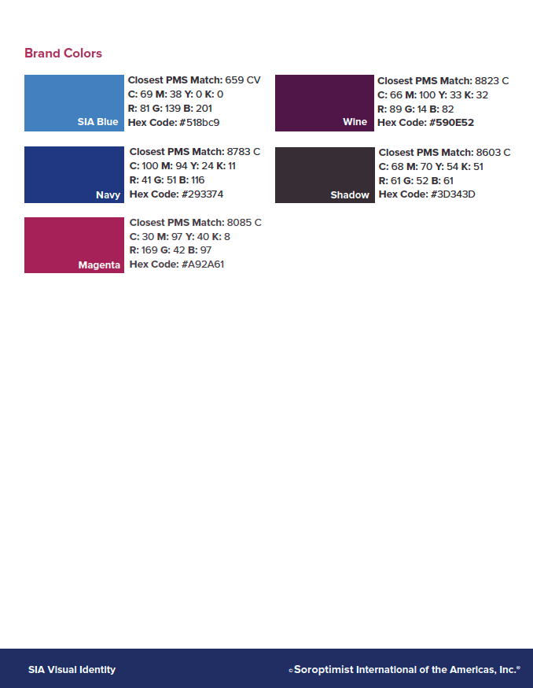
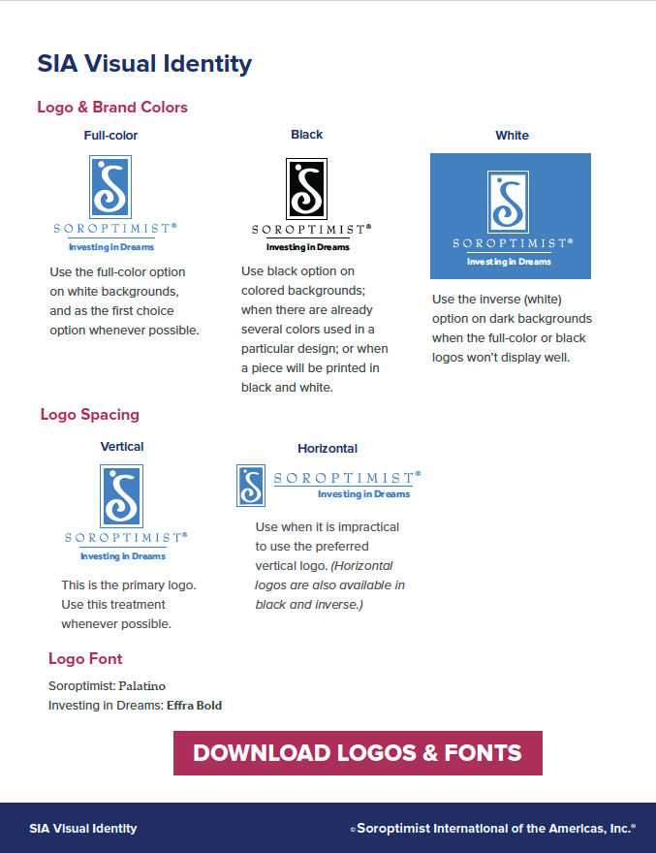
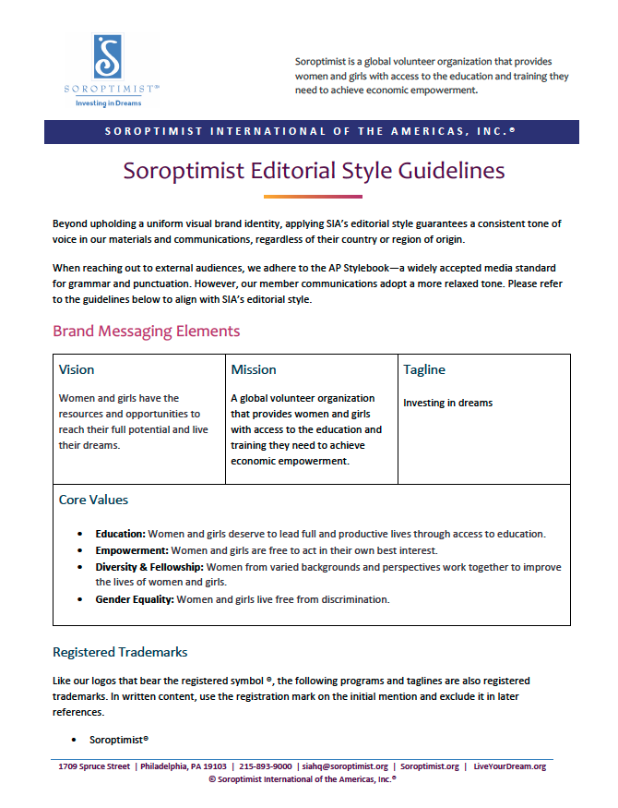
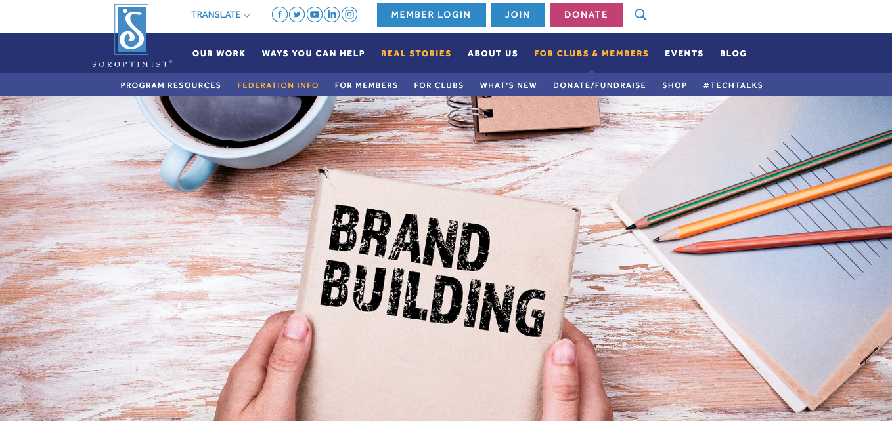
Apply Brand Guidelines – Without Losing Your Voice
Use approved logos, colors and fonts
Follow basic layout and design standards
Customize with local photos, stories and examples
Notes:
Brand guidelines aren’t meant to be restrictive—they’re meant to help. By using approved logos, colors and fonts, your materials instantly connect to Soroptimist.
You still get to highlight your members, your events and your community impact. The key is consistency, not sameness. And if branding has ever felt overwhelming or unclear, you’re not alone—that’s exactly why more tools and guidance are being developed.
SIA provides brand and style guidelines, along with customizable Canva templates and publicity kits, to help clubs incorporate local flair into their publicity materials while staying aligned with the SIA brand.

Slide 7

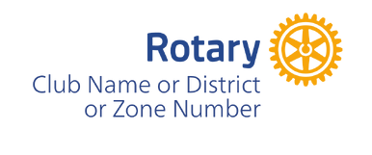


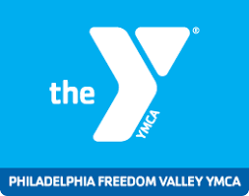
Customizable Club Logo
Coming Soon!
On-brand logo variation designed for local customization
Allow clubs to highlight their unique identity
Ideal for flyers, banners, social graphics and local publicity
Notes:
I want to pause here and share something exciting that’s coming soon—hopefully in time for the next club year. The SIA marketing team is actively working on a customizable variation of the Soroptimist logo specifically for club use. This option is still in development, but the goal is simple: to make it easier for clubs to stay fully on brand and clearly show what makes your club unique.
This logo variation is being designed with real-life club needs in mind for materials such as event flyers, banners, social media graphics, and other local publicity tools.
Many membership-based organizations with clubs or chapters—like Rotary, Girl Scouts, United Way and Special Olympics—offer customizable logos for their local groups. We want to do something similar for Soroptimist, giving clubs flexibility while still maintaining strong, consistent brand recognition.
The goal is to reduce the need for workarounds and make it easier for clubs to do the right thing from the start.

Slide 8

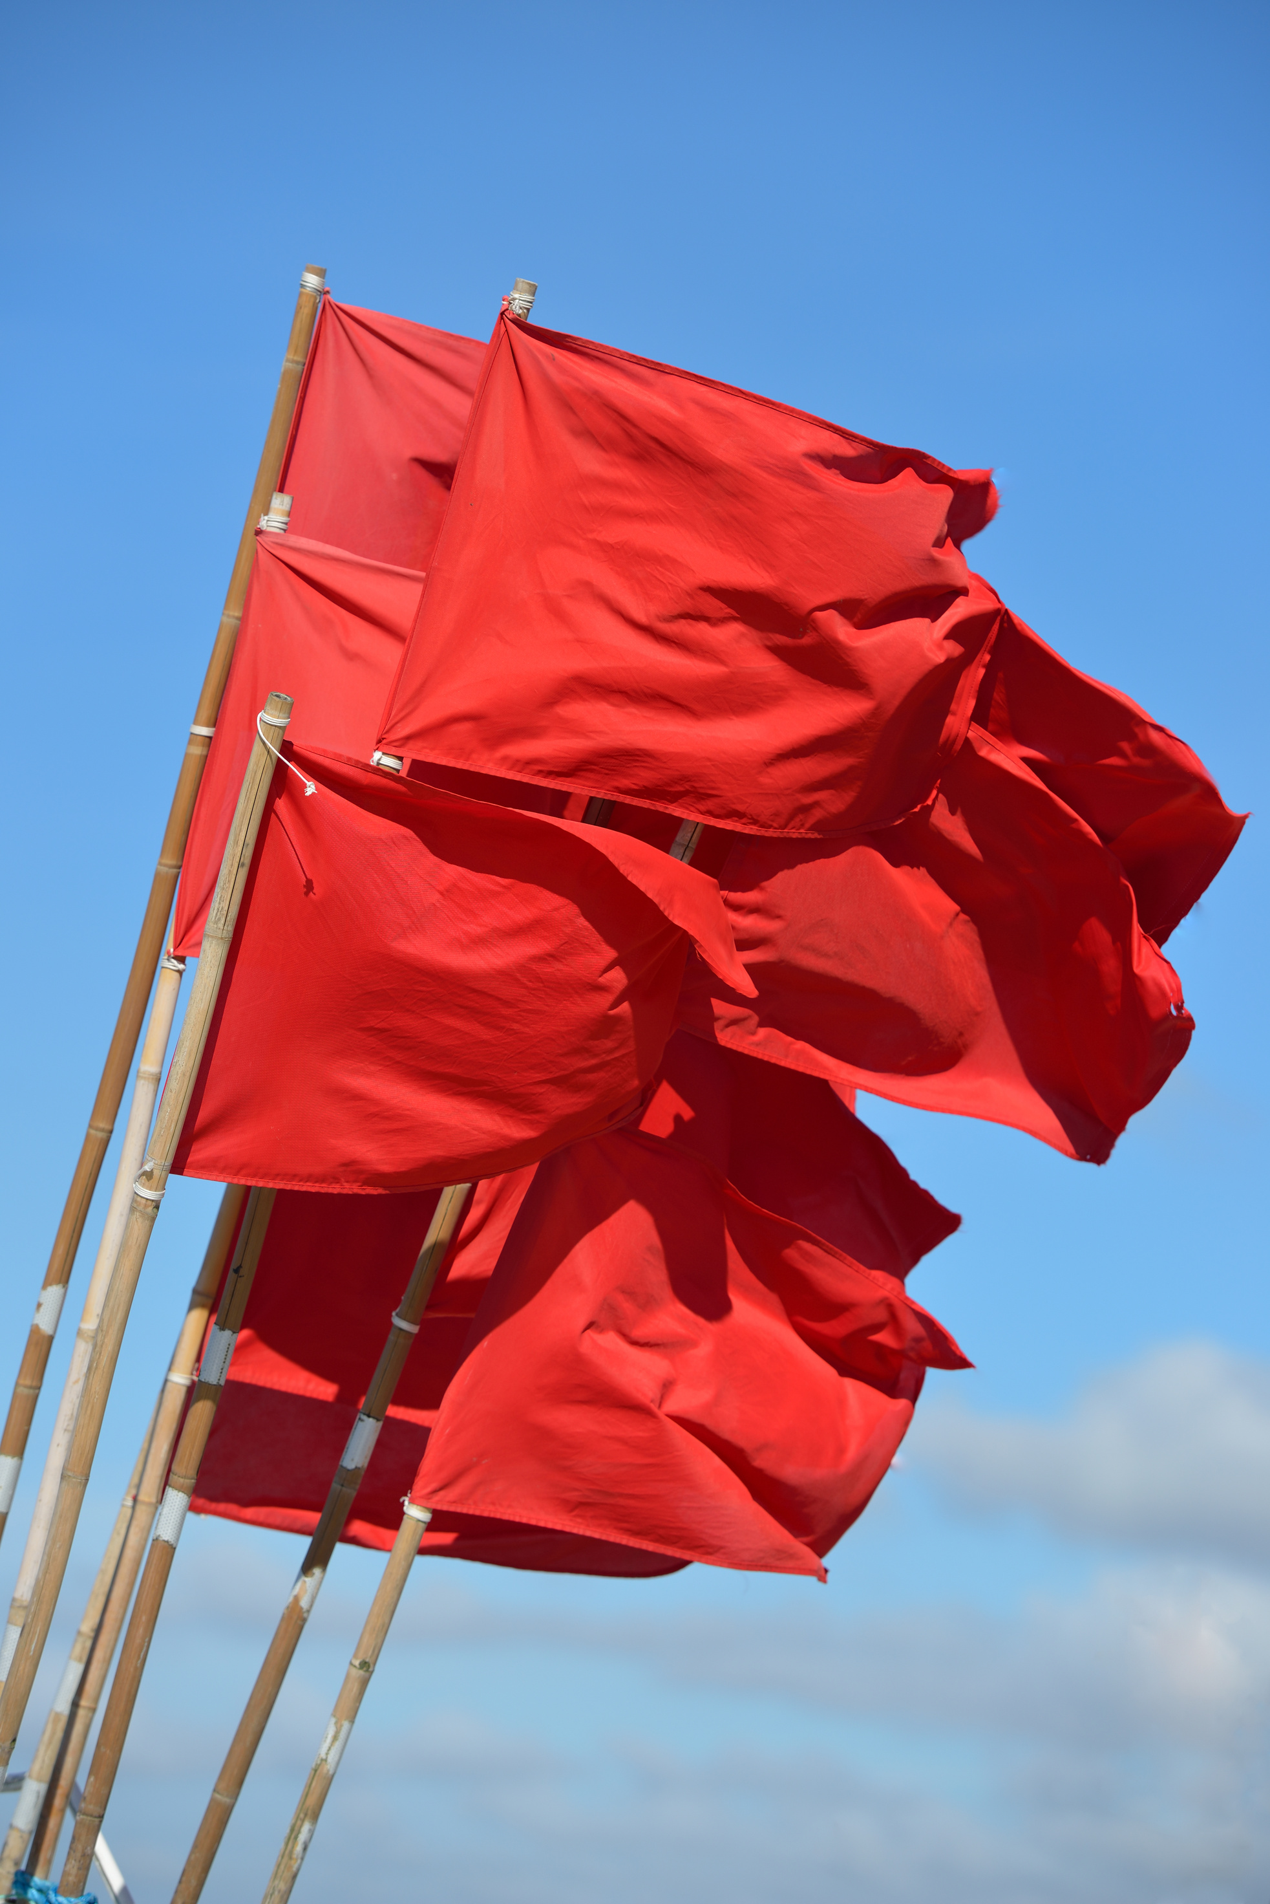


Common Branding Pitfalls to Avoid
Altering logos or colors
Mixing multiple visual styles in one place
Creating materials that don’t clearly connect to SIA
Notes:
Even small missteps can weaken your message. Altered logos, unofficial colors or inconsistent designs can confuse audiences or make materials feel less trustworthy. The goal isn’t perfection—it’s clarity. Ideally, someone should recognize your communication as Soroptimist before they even read the words.

Slide 9

Elevate Visibility & Credibility
Look professional and unified
Build trust with partners and media
Strengthen your club’s reputation
Notes:
Aligned branding helps your club stand out—in a good way. When your materials look polished and consistent, partners, media and potential members are more likely to take you seriously.
You’re not just representing your club—you’re representing a global organization with a strong, trusted reputation. That shared credibility benefits everyone.
Even more important in this digital age when materials can be created and out on the internet in a flash-by anyone.

Slide 10

Pause & Reflect
Where does your club already align well with SIA’s brand?
Where could your branding be more consistent?
Notes:
Let’s take a moment to reflect on your club’s communications—social media, flyers, emails, and presentations. Where are you already doing a great job aligning with the Soroptimist brand? Where could small changes make a big difference?
Would anyone like to share their thoughts? This isn’t about judgment—it’s about growth and opportunity.

Slide 11
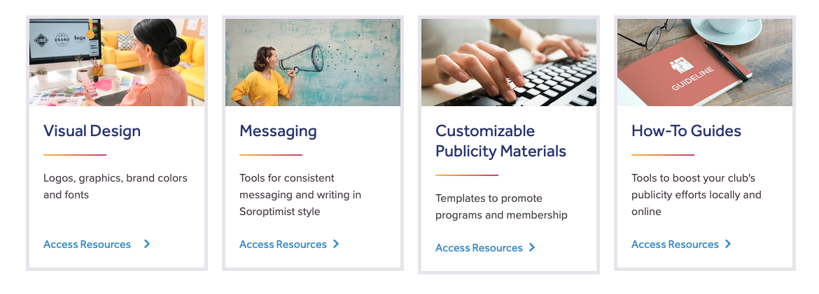
Key Takeaways
Consistent branding strengthens trust and impact
Club identity and global brand work best together
Small alignment steps can elevate your club’s visibility
Use the guidelines and materials
provided by the organization
Notes:
The big takeaway is this: you don’t have to choose between being unique and being consistent. When your club identity aligns with SIA’s global brand, your message becomes clearer, stronger and more effective.
As your region public awareness chair, I’m here as a resource—not just to share guidelines, but to support you in telling your club’s story in a way that feels authentic, confident and aligned with our shared mission.
Thank you for your time today!

