Slide 1





Big Goal Accelerator Projects
Eligibility Deep Dive
TANDA JACKSON – TREASURER ELECT
SOROPTIMIST INTERNATIONAL OF THE AMERICAS, INC

Slide 2

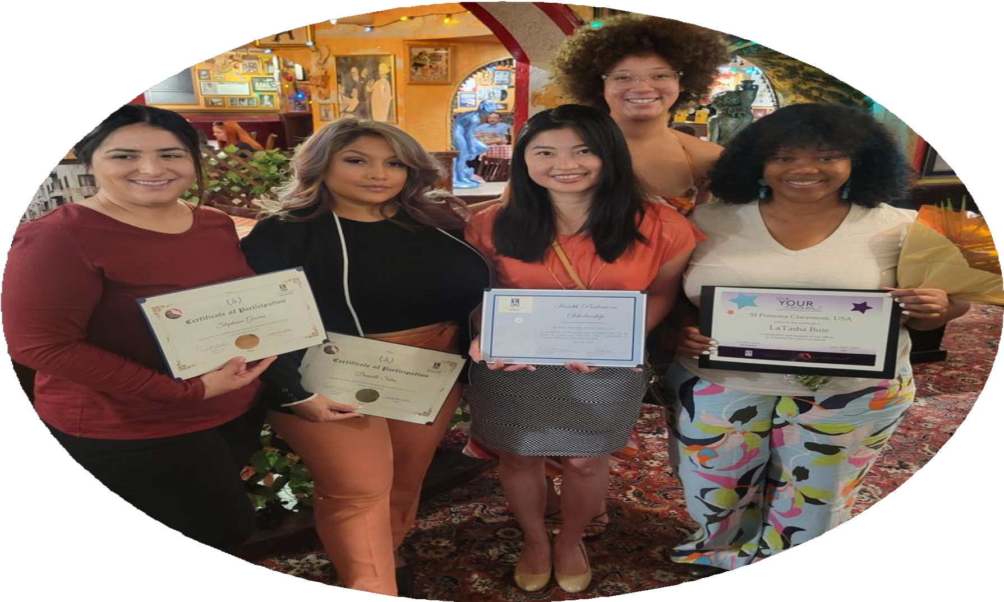

Learning Objectives
Understand the eligibility criteria for Big Goal Accelerator Projects.
Identify common challenges that often lead to project ineligibility.
Apply Big Goal Accelerator Project eligibility knowledge to develop new projects.

Slide 3




SIA BIG GOAL
Invest in the dreams of half a million women and girls through access to education.
x 500,000
empowered to live their dreams

Slide 4

What is a Big Goal Accelerator Project?
Serves women and girls who face obstacles
Increases access to education/ economic empowerment
Soroptimist-led
Reported to SIA

Slide 5









Serve Women and Girls Facing Obstacles to Success
Poverty
Teen parenting Language barriers Foster care Substance use Homelessness
More than gender alone

Slide 6




Why not the Dream Programs?
GOOD FAITH EFFORT
Try not to double count!
500,000
Individual women and girls

Slide 7
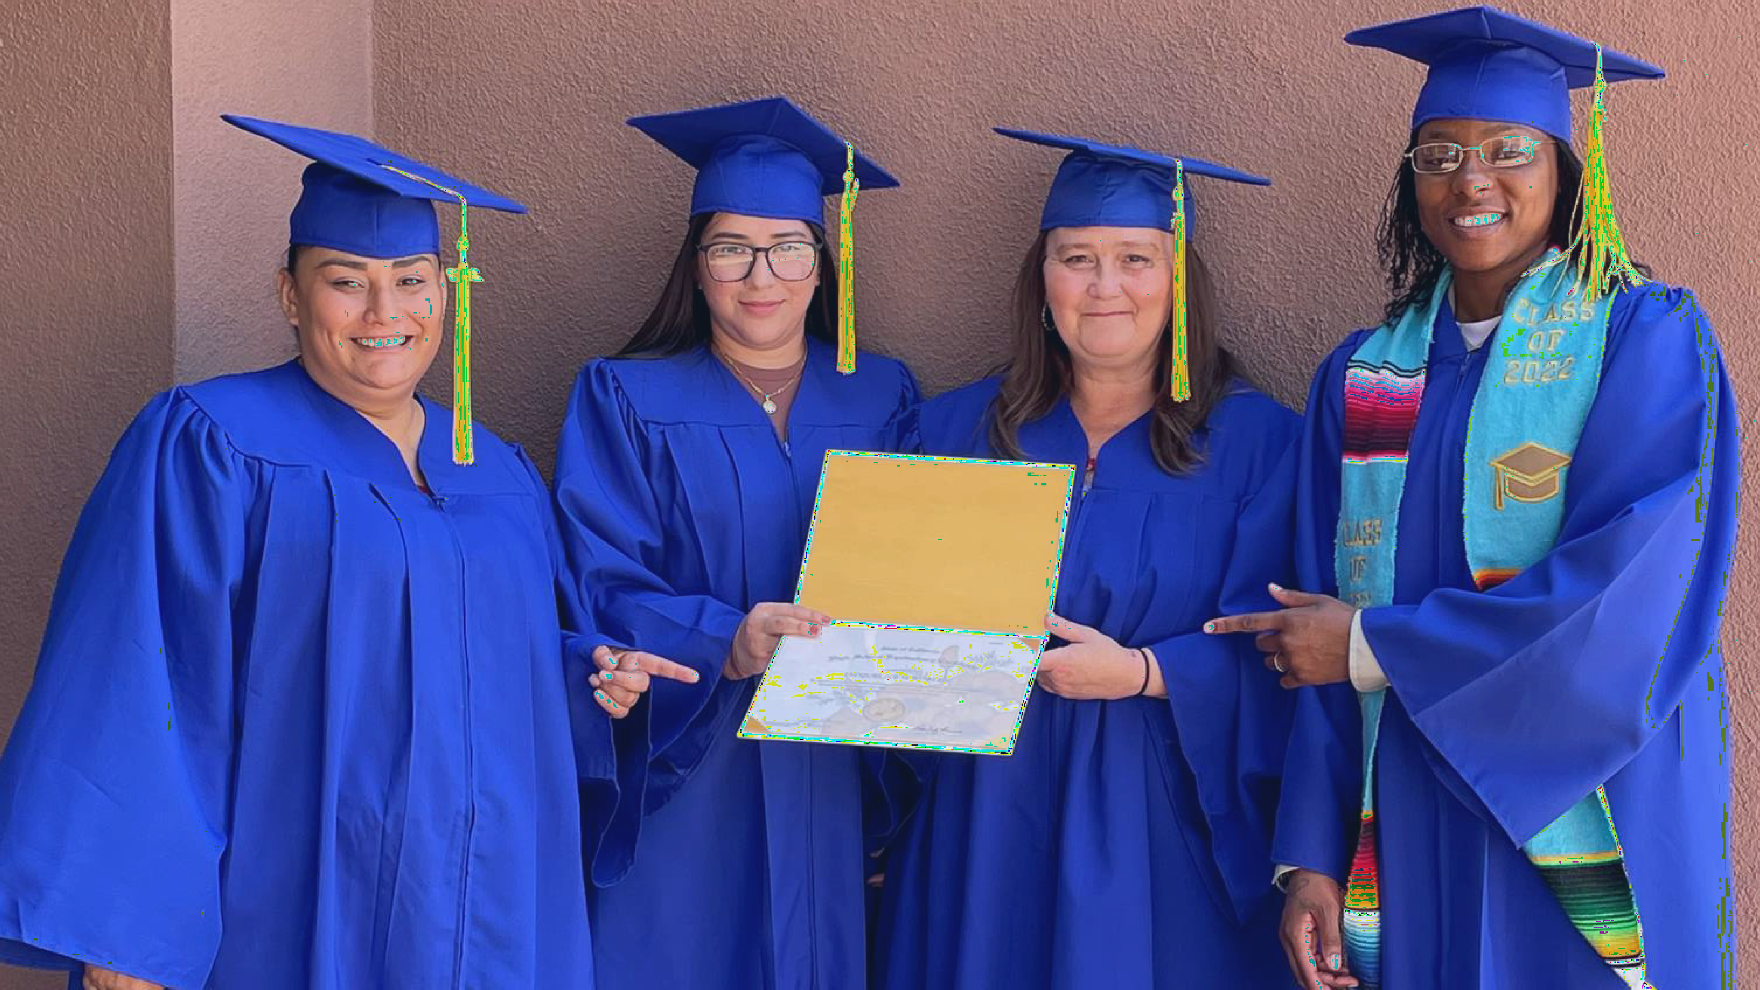

Access to Education or Economic Empowerment

Slide 8

Access to Education
or Economic Empowerment
Education vs.
Education AL
Formal Education = structured program
(certificate, diploma, degree)
EducationAL = awareness raising, but not increasing likelihood of a credential

Slide 9
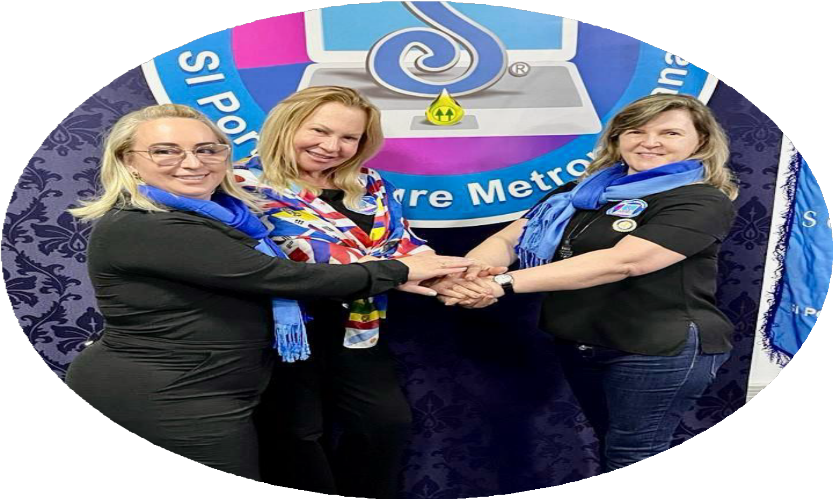
Soroptimist-led
Driven by members
Not a donation to another organization
Hands-on participation from club members

Slide 10


Report to SIA
BY JUNE 30
Questions? Email program@soroptimist.org

Slide 11




Not Eligible Projects
Awareness raising projects
General social empowerment
Dream Programs
work
Beautification projects
Supporting other orgs

Slide 12
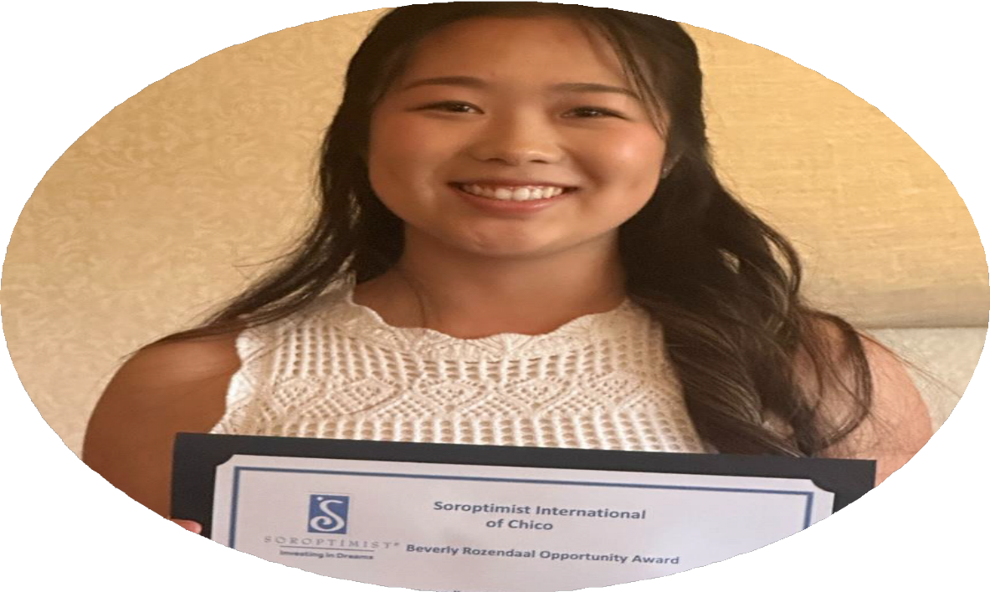
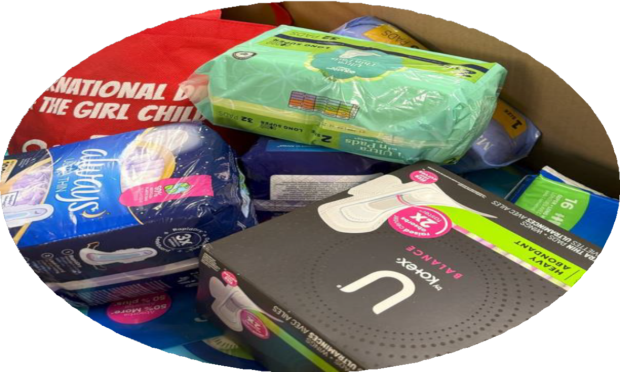
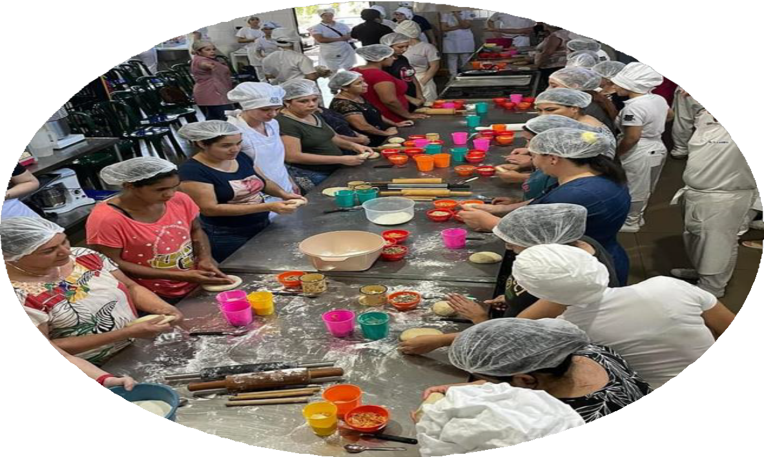

New Project?
Start with one of these projects!
Give a scholarship or award
Remove obstacles
Provide a class

Slide 13



Give a SCHOLARSHIP or AWARD
Not eligib
Live Your Dream Awar
applicant?
Give a different scholarship!

Slide 14

Remove Barriers
Bonus: Participate in May’s UpliftHER focus - Period Poverty!
Provide items required for education or
work
Menstrual products Licensure or testing fees Textbooks
Gas cards
Professional clothing or uniform pieces
Ask local agencies what women and girls need

Slide 15

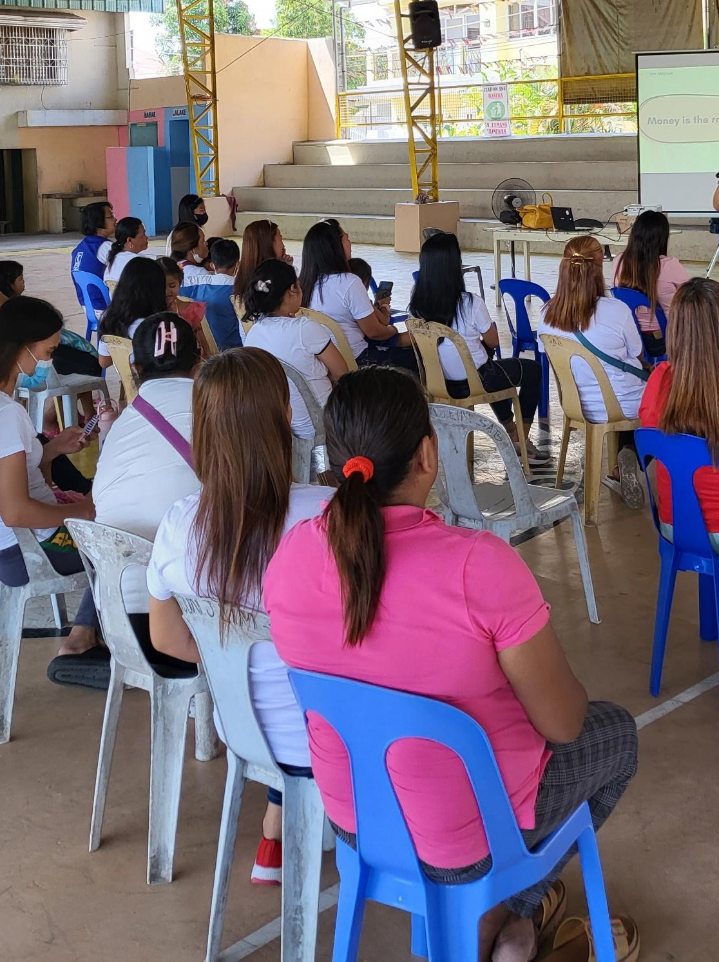
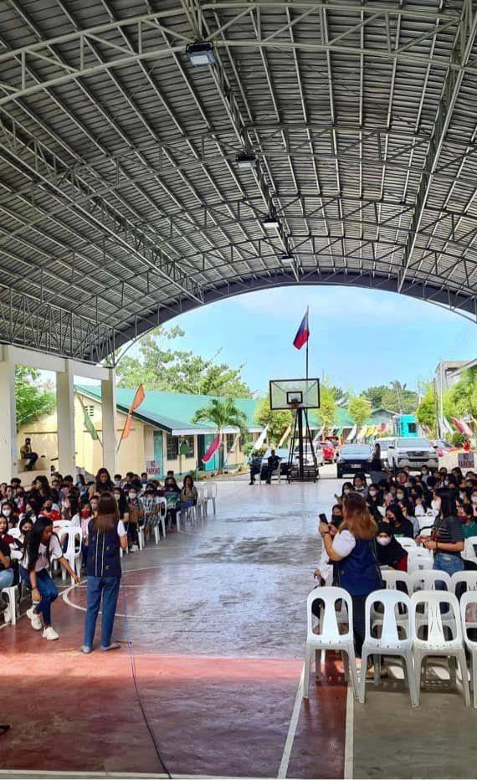



Consider Project Reach
Laptops for 2
girls
Skills
workshop for 50 girls

Slide 16
Legacy Projects
Consider adapting projects to be eligible for our Big Goal
What’s missing?
Population
Focus
Soroptimist-led
Who are we serving?
Do they face obstacles?
Does this project focus on increasing access
to education or work?
Are Soroptimists leading this project?

Slide 17


Self-defense and trafficking awareness classes to low-income girls
WHAT TO CHANGE?

Slide 18
Donation to local agency providing GED classes
WHAT TO CHANGE?
DONATE

Slide 19

Laptops for boys and girls as an award for community service
WHAT TO CHANGE?

Slide 20


Thank You!

