Slide 1

Empowering Every Member through Financial Clarity:
Transparency from Club to Region
Kim Grossman, SIA CFO
SOROPTIMIST INTERNATIONAL OF THE AMERICAS, INC

Slide 2

Agenda
Introduction
Non-Treasurer Responsibilities
Treasurer’s Reports
Call for Feedback
Our Team & Conclusion

Slide 3

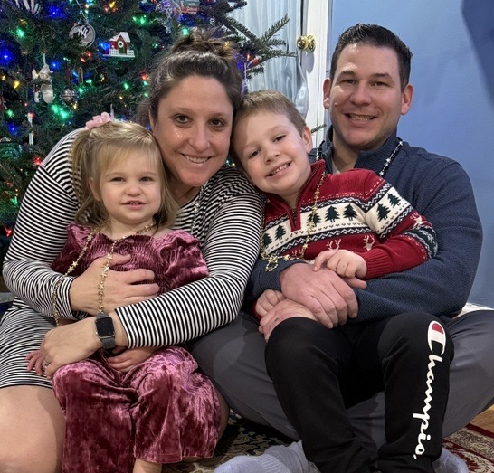
Introduction
CFO since March 2023
Not-for-Profit Auditor – 15+ years
Philadelphia, Pennsylvania

Slide 4
Treasurer’s Reports - Frequency
Monthly
Annually
Quarterly
Cash Roll Forward
Cash Roll Forward
Budget vs. Actual

Slide 5

Treasurer’s Reports – Budget vs Actual
Budget = The Plan
Actively Monitored
Dollars and Cents
AND
People Power
Stay on the approved path
Update or change plans when necessary
Accountability & Shared Responsibility
Trust & Transparency
Not just Treasurer & President’s Responsibility
Accurate & Timely Reporting
Invested in Club’s financial health
Increased understanding of constraints

Slide 6
Transparency Toolkit
Progress toward
our mission
Aligned with Budget
Restricted vs. Unrestricted
Recommendations or
Red Flag
Bridge the gap between the $$ and the actual work being done for women and girls
Active budget monitoring and “steering the ship”
What money is actually “spendable” for operations, new ideas or emergencies
Shifts the conversation to the Treasurer’s analysis rather than just raw data

Slide 7


SIA HQ Team

Slide 8

Resources
Club Treasurer Guidelines
(For Clubs & Members → Club Management Resources → For Clubs → Club Administration → Club Officers

Slide 9
Resources
“Transparency Toolkit”
(1) How does this report reflect our progress toward our mission this month?
  Why it matters: This bridges the gap between the numbers and the actual work being done for women and girls.
(2) Are our current expenses aligned with the budget we approved at the beginning of the year?
  Why it matters: This encourages active budget monitoring rather than just "filing" the report away.
(3) What portion of our available funds is 'Restricted' for specific projects versus 'Unrestricted' for general operations?
  Why it matters: This helps members understand what money is actually "spendable" for new ideas or emergency needs.
(4) What are the specific recommendations or 'red flags' we should be aware of in this month’s activity?
  Why it matters: It shifts the focus to the Treasurer’s expert analysis rather than just the raw data.
EXTRA CREDIT: Is there any part of this report that feels unclear, and how can we make it more accessible for everyone next month?
  Why it matters: This reinforces the idea that financial clarity is a collective goal, not a solo task for the Treasurer.

