Slide 1

Infusing JOY into Membership
Michelle G. Strawser &
Adrienne Griffitts
~Region Joy Officers
SOROPTIMIST INTERNATIONAL OF THE AMERICAS, INC
Notes:
We are excited to talk to you today about how we can infuse JOY into the membership experience.

Slide 2
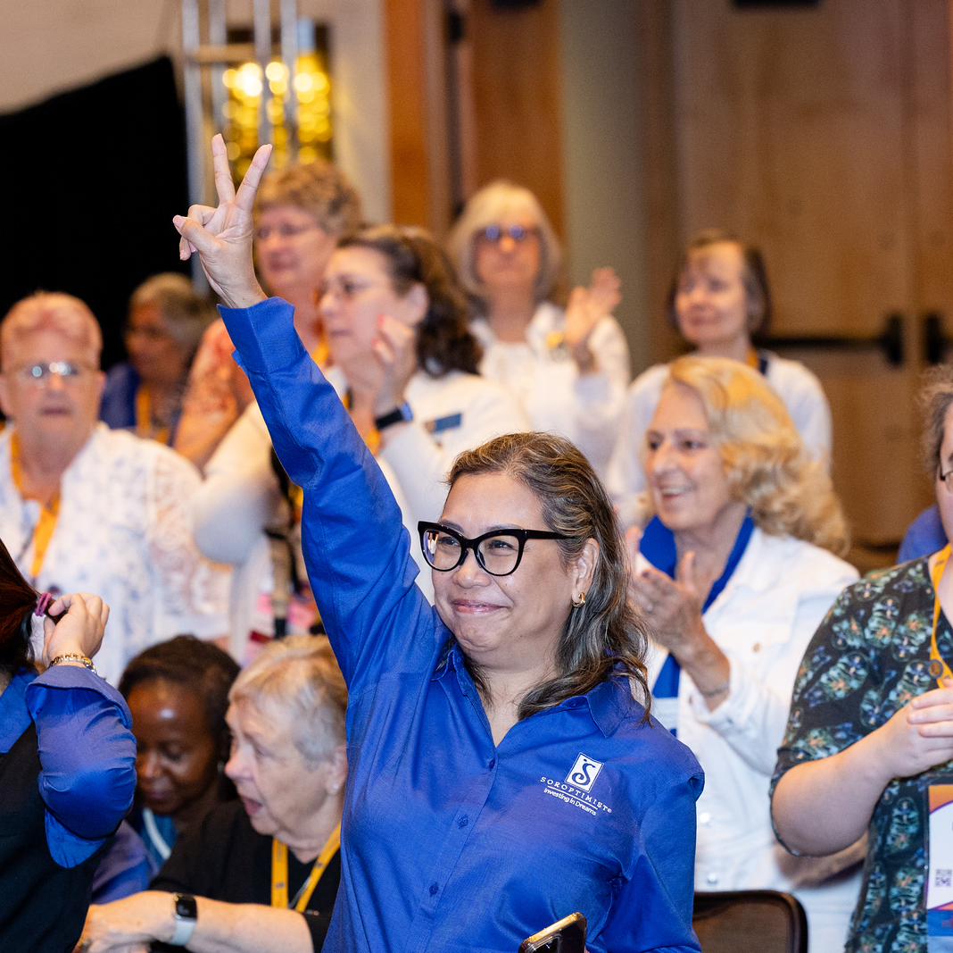

Imagine…
A time you felt joy
Notes:
I want you to close or lower your eyes. Imagine the last time or a memorable time you felt joy. Maybe it was sharing a laugh with friends, or playing a game with a grandchild, or wrapping up a particular successful Dream It, Be It project with your club. Maybe you reached a goal at work that you’ve been striving towards for a long time. Or maybe you won the top prize at a recent Soroptimist fundraiser!
Now, open your eyes. Does anyone want to share something recently that gave them joy and how that felt?
(take some responses)
(follow up with this question if no one gave a Soroptimist example)
Did anyone have a joyful memory that they conjured up from a Soroptimist experience? What was it?
(take some responses)
Thank you all for sharing those powerful and joyful moments!
While we’re all united by our mission to empower women and girls through access to education, sometimes the stresses of planning meetings, obtaining background checks in time for a youth project, or fundraising can crowd out the meaning and the fun. This session will give you ideas for how to infuse joy into your club’s membership experience for yourself and others.

Slide 3
Joy Sappers
Civility issues
All work and no play
Difficulties with new initiatives
Notes:
First, what are the kinds of things that can drain joy from the membership experience and how can we mitigate those?
Civility issues—It is no surprise that interpersonal issues can be very draining. If you are facing these, your club president or region governor can be of service.
All work and no play—if your time with Soroptimist is solely focused on things that don’t feel fun for you, it certainly can sap your joy. Everyone is different so while some people may find the work of being treasurer tedious, other members may love the detail oriented work, so this is unique to the individual. It’s key to make sure you employ some of the ideas we’ve learned today to help add some play back into your work/play balance!
Difficulties with getting new initiatives off the ground—no matter how enthusiastic you and your club are about starting something new like a member recruitment strategy, a new fundraising event, or a first-time Dream It, Be It project, it can be difficult to make connections to launch something or get everyone on board with something new. In these cases, it can be good to share the workload with other members so that no one person gets burnt out.

Slide 4

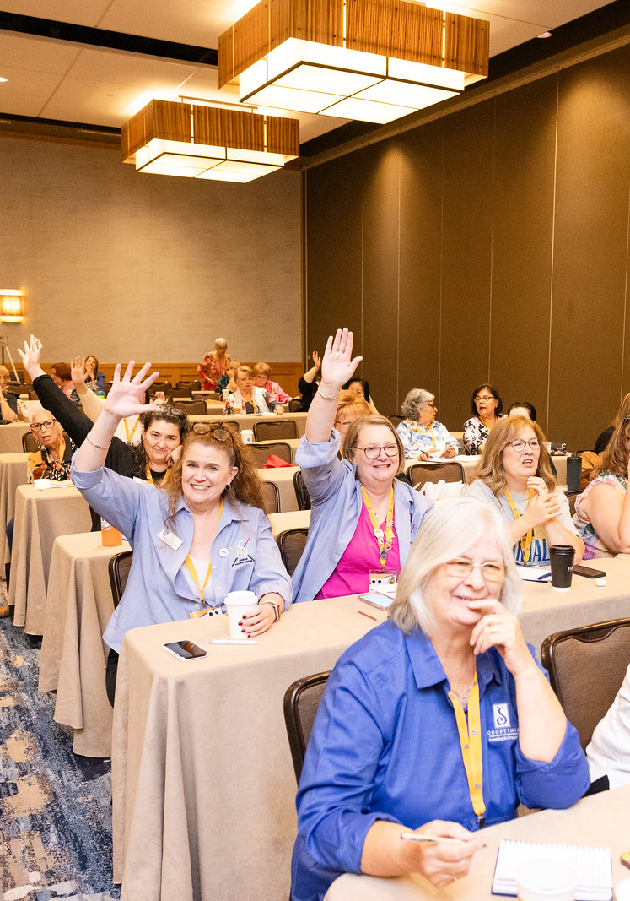
What is JOY?
  Happiness
  Delight
  Surprise!
Notes:
Now, let’s focus on more cheerful topics—what is JOY comprised of? There are lots of ways to think about joy, but for our purposes today, we will be thinking about ways to increase happiness, delight, and even surprise for yourself and other members in your club, district, or region.

Slide 5

New experiences enrich time passing
Notes:
Scientists have found that one of the ways that makes time feel like it’s passing more slowly and feel more rich is when we experience something new—think of a time when you traveled to a foreign country or somewhere totally different from where you live. The first day in that new place often feels so long because you’re getting used to a new place, new time zone, different currency, and possibly different social norms.
This novelty is why time seems to pass so slowly when we are children because the world is so new to us! As adults, we can find ways to add novelty to things we do frequently to make them feel fresh and new again.

Slide 6
How to Add Joy
Novelty
Change things up! From membership to program to fundraising
Notes:
So, what does that have to do with adding more joy to your membership experience? Adding in novelty will help make meetings and events more memorable, especially for potential members who may be more likely to join!
Consider ways to switch things up: can you meet in a different location? Could you do a walking meeting in a local park (with a stop at a picnic table to take notes if needed)? If your club has been celebrating Live Your Dream Awardees at the same location for several years, maybe it’s time to consider something new or more family friendly so their children can attend and celebrate them too. Perhaps your club could add a new component to a legacy project that would make it Big Goal eligible and engage different participants. Maybe it’s finding a new fundraising activity to engage different possible donors and supporters. The sky is the limit!

Slide 7
How to Add Joy
Novelty
New
Members
Change things up! From membership to program to fundraising
Give new members a warm and supportive welcome!
Notes:
Speaking of novelty, a key way to infuse more joy into the experience is to recruit new members and welcome them warmly to your club! Make new members feel valued from day one with a thoughtful process of introduction to your Soroptimist club, including welcome kits, personalized messages of welcome from fellow members, and a buddy or mentor system to help them navigate things. As we all know, there is a lot of Soroptimist specific lingo to learn and it can help to have a friendly face as you’re taking it all in!

Slide 8
How to Add Joy
Novelty
New Members
Celebrate!
Celebrate member’s hard work and contributions at meetings, in newsletters, on social media.
Change things up! From membership to program to fundraising
Give new members a warm and supportive welcome!
Notes:
Of course, we can also celebrate and recognize all members publicly and privately. Celebrate members through highlights in your club or region newsletters, social media posts, or at events to thank them for their time and talent contributed to bringing the mission to life. Bear in mind that some members may not love the spotlight so if you know a member is shyer, they may appreciate a kind email or private remark instead of an announcement at a crowded event!

Slide 9
How to Add Joy
Novelty
New Members
Celebrate!
Learn Together
Celebrate member’s hard work and contributions at meetings, in newsletters, on social media.
Change things up! From membership to program to fundraising
Give new members a warm and supportive welcome!
Let members who are knowledgeable share their knowledge!
Notes:
You also can consider doing occasional learning style meetings where a member knowledgeable about a certain aspect of Soroptimist presents to the rest of the club—perhaps the Live Your Dream Award chair gives a deep dive into the awards program, eligibility, and the stories of recent award recipients, or a long-time member can give a presentation about the history of the club. This is a great way for members to feel valued for their expertise and for all members to benefit from their knowledge---and it may even spark a member to get involved in an area of Soroptimist they’d never considered!

Slide 10
Icebreakers and Discussion Prompts
Seasonal themes
Greatest impact
Excited at new year
Look up conversation starters
Notes:
Another way to infuse joy is to lead ice breakers and discussion prompts—these are especially helpful to get new members into the fold and help them feel that they’re connecting with their club. You can tie ice breakers or discussion prompts these into seasonal themes like gratitude—what are you grateful for in your Soroptimist experience? At the conclusion of a club year, what moment of Soroptimist work had the greatest impact on you? Or perhaps at the start of a new year, what are you excited about for the club or yourself this year? There are lots of ideas for conversation starters that you can find online to get you started.
These kinds of activities are important, because they help forge connection within and beyond the Soroptimist mission. Even if your club may have several members who know each other well, you’d be surprised at what you can learn about each other or see what you have in common.

Slide 11
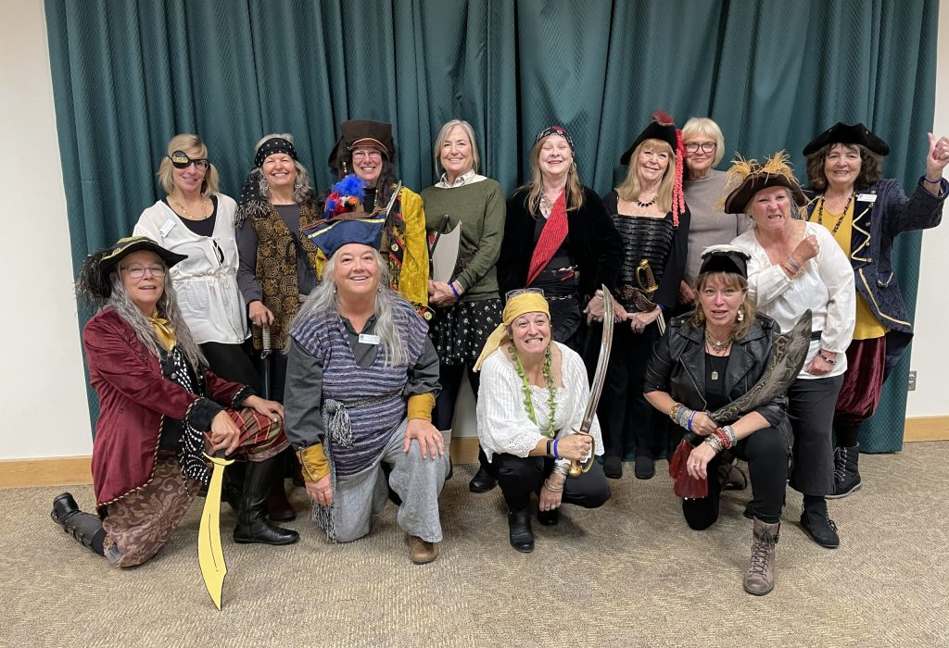
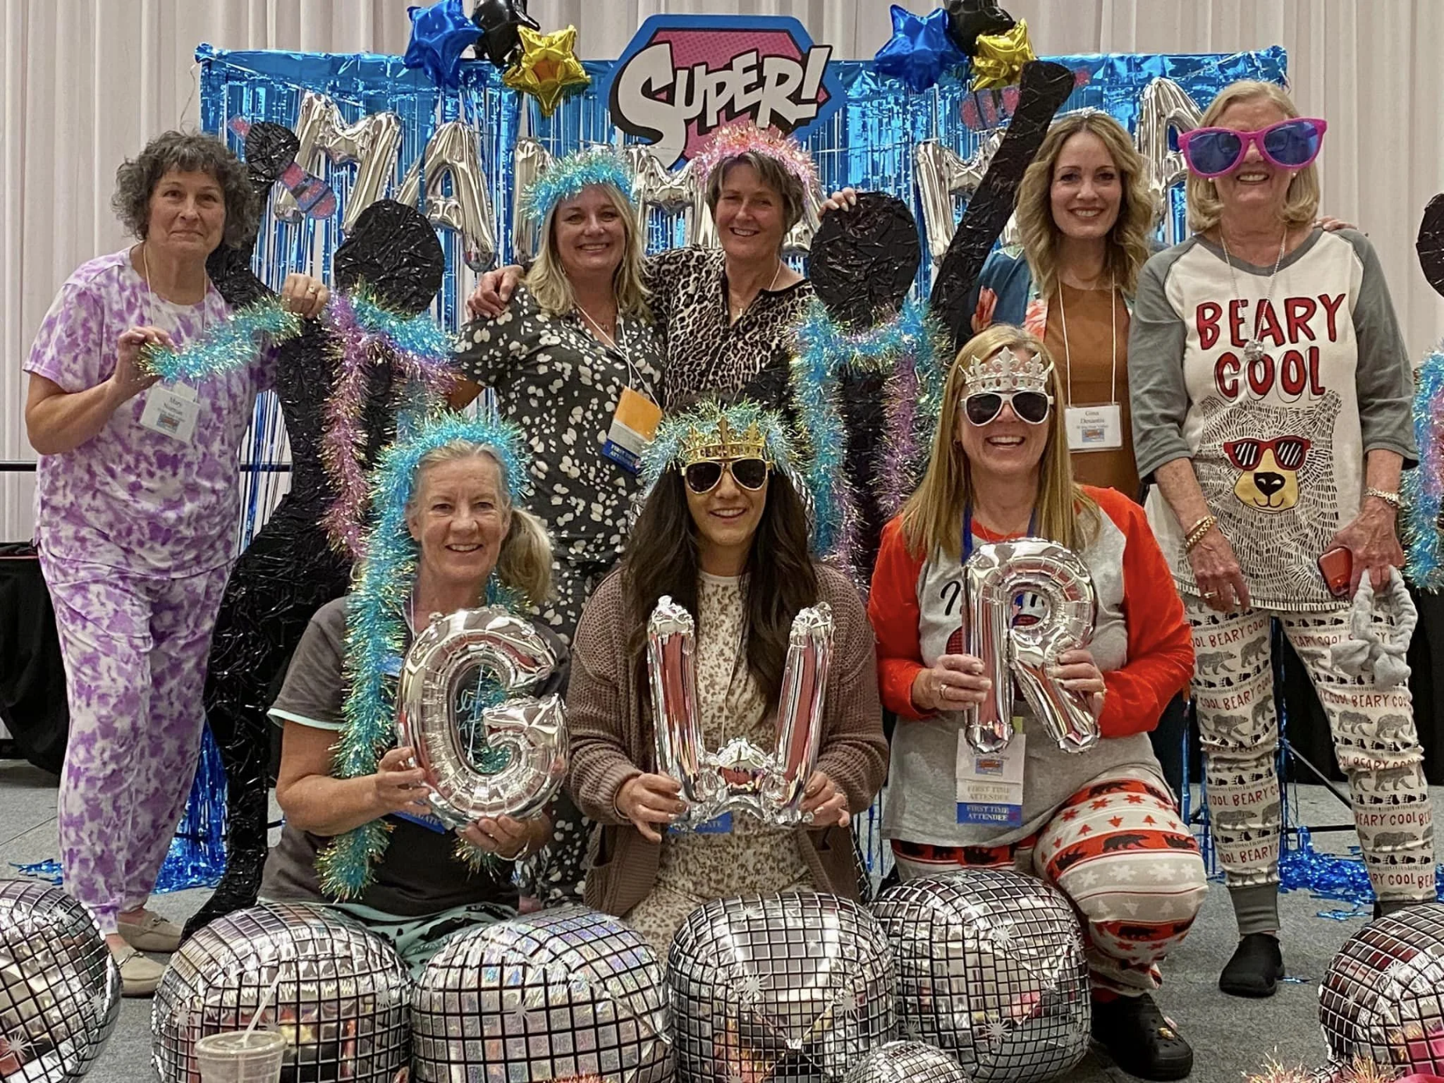
Have fun!
  Costumes or themes
  Games
  Move together
Notes:
Finally, don’t be afraid to be a bit silly—try a costume theme for a fundraiser or even regular meeting, or play a brief game or do a quick chair yoga stretch as a group before any meetings that you know will be long and potentially tedious. These moments can be some of the most memorable in your Soroptimist experience, so don’t discount them.

Slide 12
Share & Discuss
What would work well for your club?
What are you excited about?
What does your club already do for joy?
Notes:
(engage in discussion here if time permits)
Now, I’d love to hear from you—what’s one idea here that you’re excited about or think would work well? Or what’s something that your club already does that infuses joy into the membership experience?
(take suggestions/ideas as long as time permits)

Slide 13
Thank you!
Notes:
As I wrap up, I just want to leave you with one final thought: Just because our mission is important and the work we do to support women and girls changes lives doesn’t mean that we can’t have fun doing it! Thank you for your time today.

