Slide 1




Transformation Through Leadership
When women lead, lives change.
SOROPTIMIST INTERNATIONAL OF THE AMERICAS, INC

Slide 2



Leadership Is a Choice
Courage over comfort
Listening with empathy
Acting with compassion
Opening doors for others

Slide 3
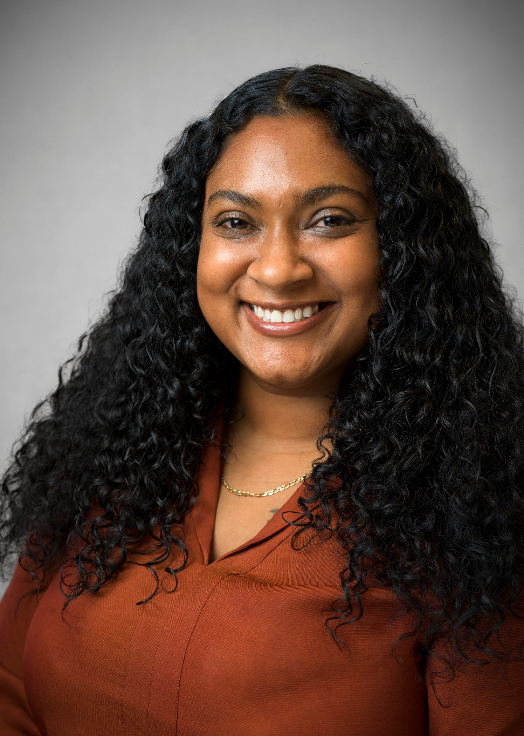

One Woman. One Opportunity.
Generations Changed.
Kharmen
Live Your Dream Award Recipient | 2018

Slide 4
Your Leadership Is the Next Spark
$3.4 million invested in women’s education
2,300+ women
supported worldwide
31,000 volunteer hours
646 new members
Together, we transform the world.

Slide 5


Our projects may look different, but our purpose is the same:
to help women and girls gain education, confidence and opportunity.

Slide 6
Small acts,
multiplied across hundreds of clubs, will change the world.

